Slide 1
Software Engineering
Lecture #31
Fakhar Lodhi

Slide 2
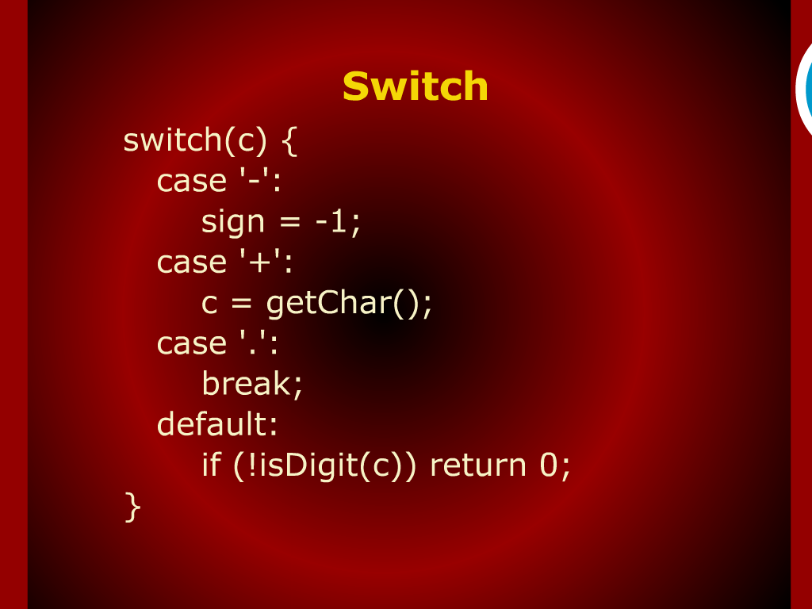
Switch

Slide 3
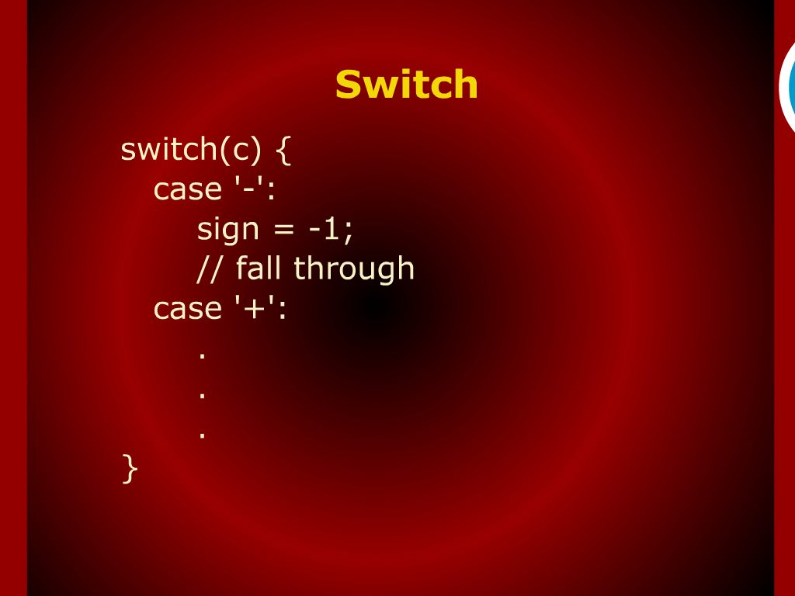
Switch

Slide 4
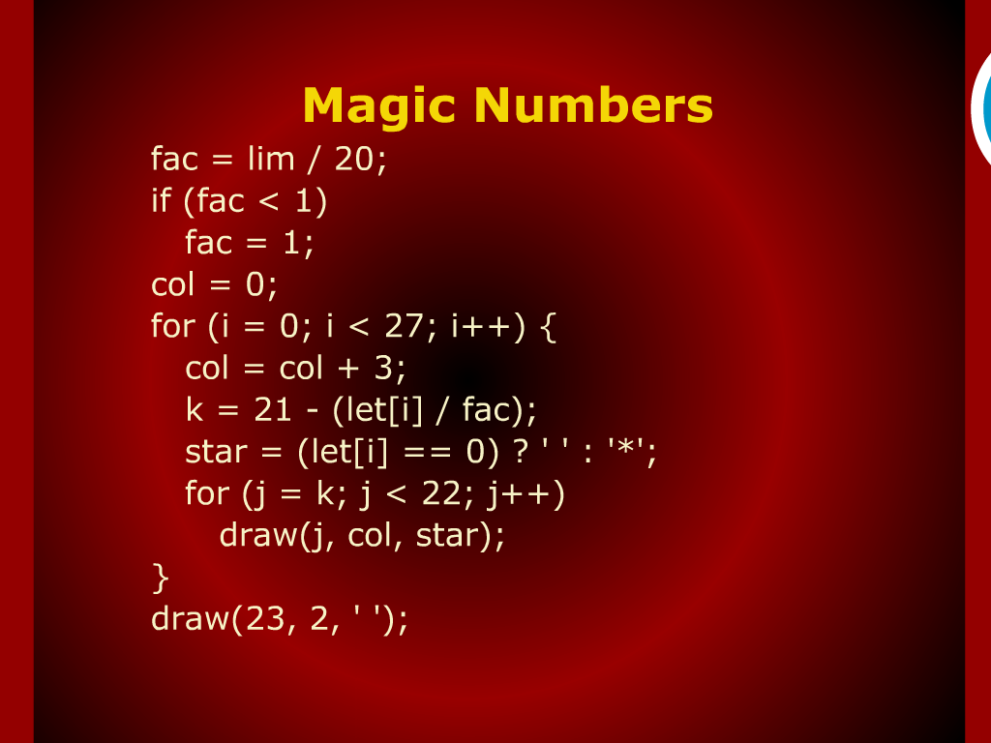
Magic Numbers

Slide 5
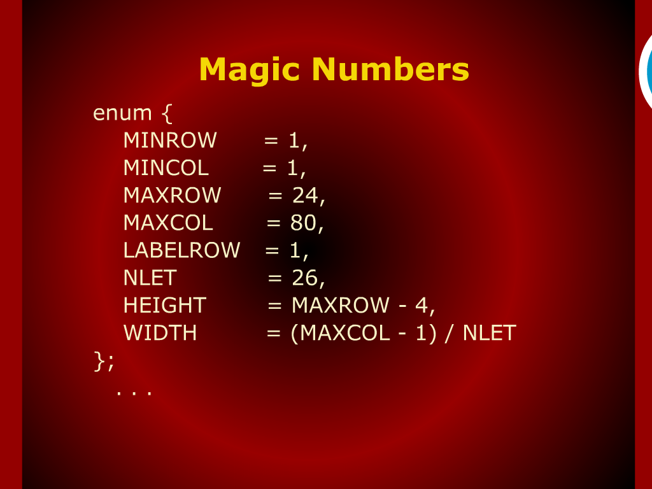
Magic Numbers

Slide 6
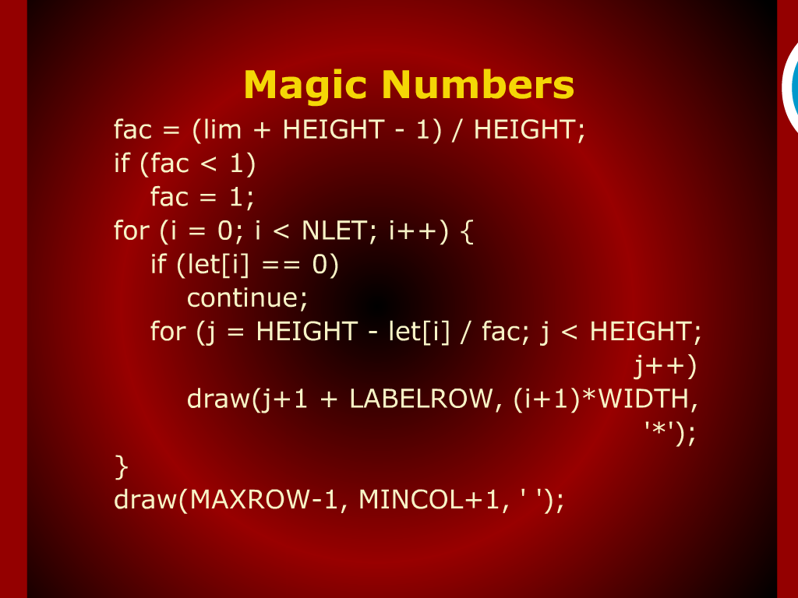
Magic Numbers

Slide 7
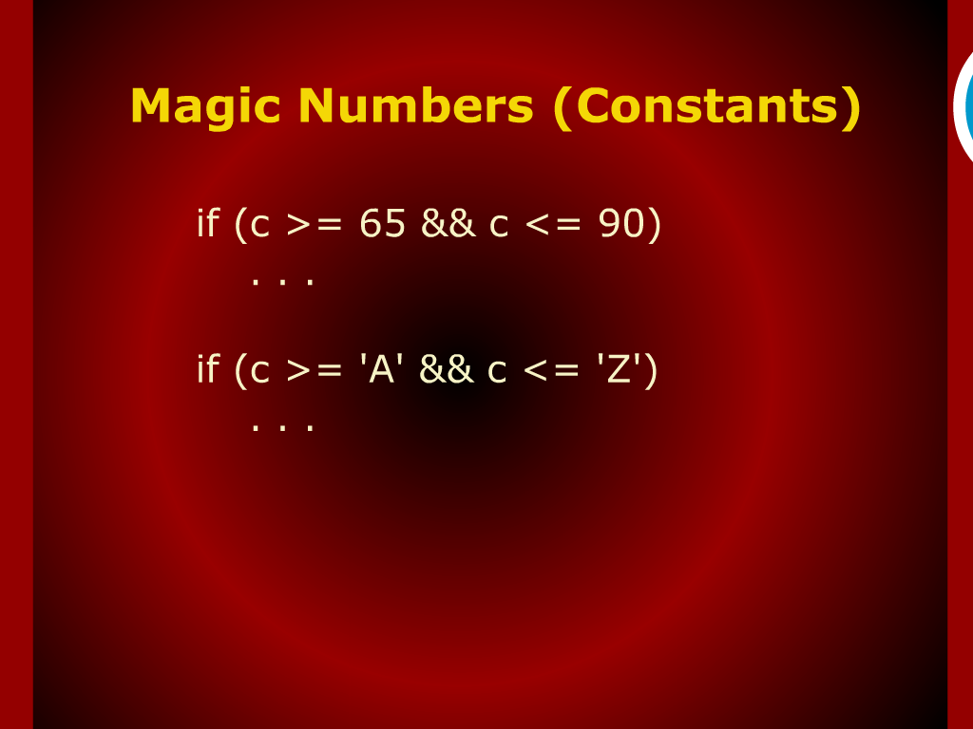
Magic Numbers (constants)

Slide 8
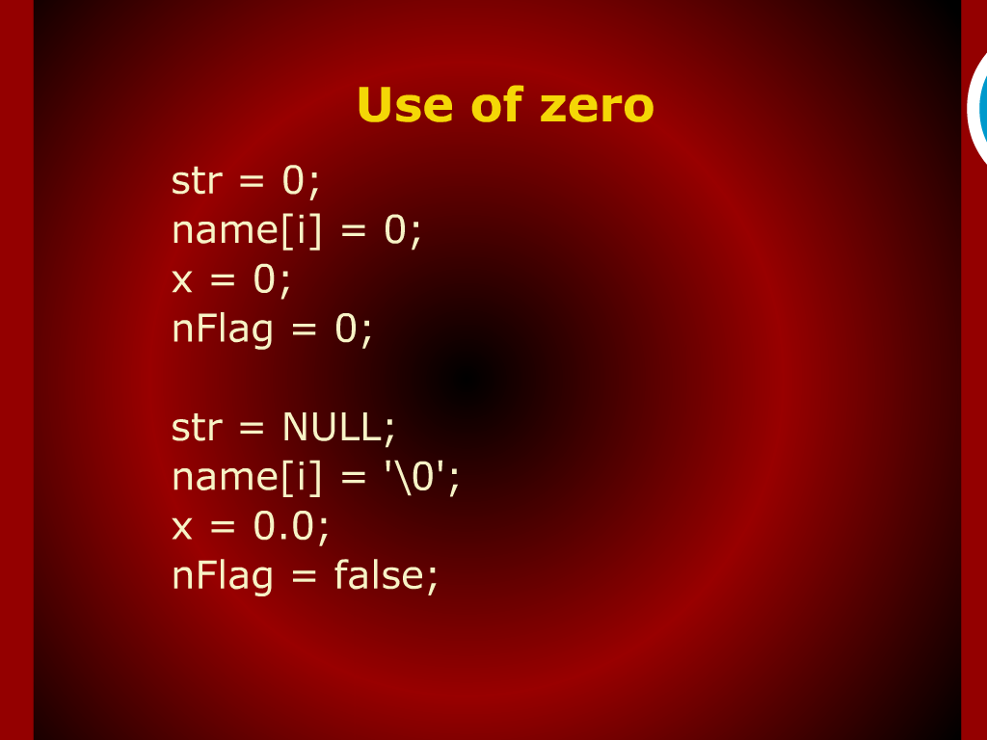
Use of Zero

Slide 9
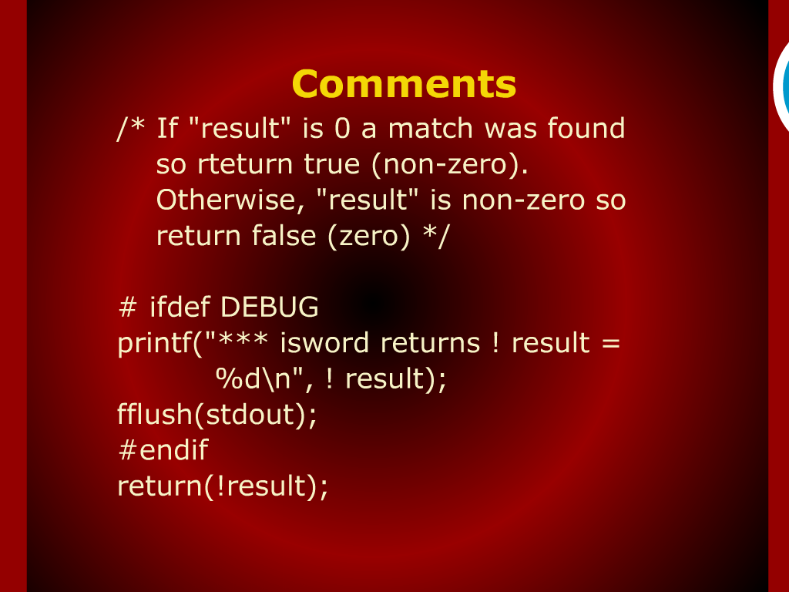
Comments

Slide 10
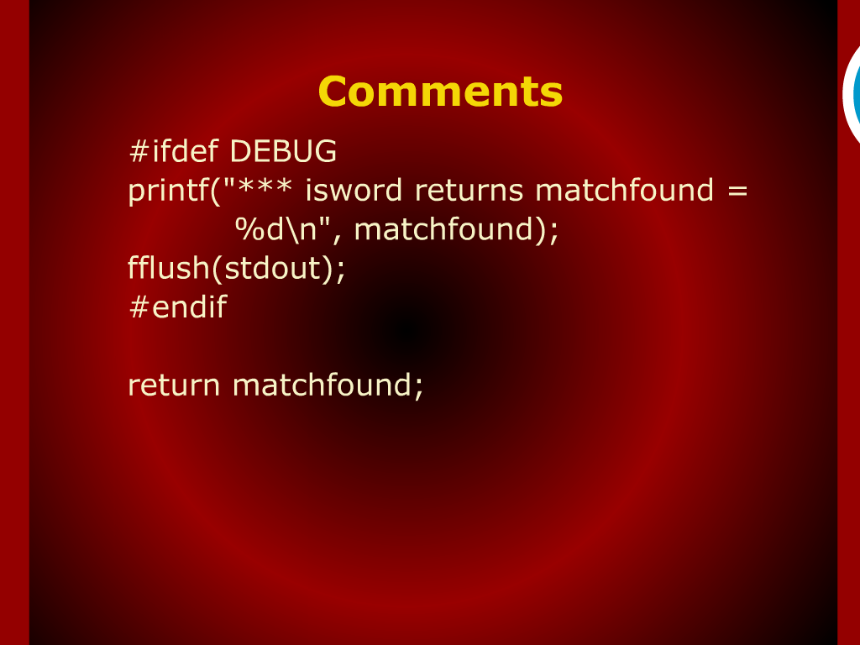
Comments

Slide 11
Summary of Today’s Discussion

Slide 12
Comments

Slide 13
Use of Zero

Slide 14
Magic Numbers

Slide 15
Simplicity and Clarity

